Slide 1


Immigrant students in Europe suffer from lower grades: some social and scholastic features are the key to explain it
Giulia Bergonzoli, Ettore Busani, Sebastian Castellano, Lucia Gregorini
Applied Statistics 2022 – Politecnico di Milano
Tutor: Chiara Masci

Slide 2


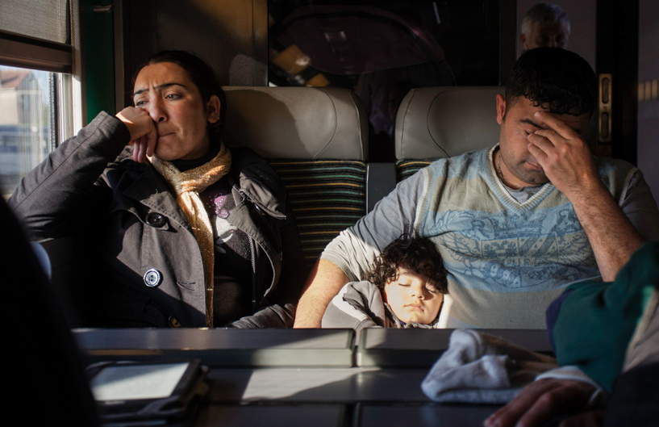

How do immigrant students face up when compared to native students?
Which features are most important when it comes to their scholastic success?
Which are the main differences in their scholastic, familiar, psychological characteristics?
How can we take example from the best European countries with respect to integration to help these students?

Slide 3

Come and have a look at what we found!

Slide 4

Our methodology
During our analysis we used many different techniques that we progressively learned during the course:
Clustering
Manova
Linear Models
Linear Mixed Models
Multinomial Logistic Regression

Slide 5


Slide 6
How do immigrant students face up when compared to native students?

Slide 7
Immigrant students in Europe suffer from lower grades: some social and scholastic features are the key to explain it
Giulia Bergonzoli, Ettore Busani, Sebastian Castellano, Lucia Gregorini

Slide 8
How do immigrant students face up when compared to native students?
Which are the main differences in their scholastic, familiar, psychological characteristic?

Slide 9
Our results
We were able to find statistically significant differences among students, schools and countries. We proved that immigrant students often find themselves in a disadvantageous position and that their ability to score high grades is influenced by their resources and social class of origin.
We managed to identify the critical characteristic that positively or negatively impacted the performance of students. Based on these findings we provided some possible improvements to be implemented by school or countries policies.

Slide 10

Our Goal
The goal of our project is to find quantitative evidence of the differences between native and immigrant students across Europe. We want to measure the level of integration of European schools by analyzing the scholastic, social and economical status of their students. We aim at identifying the most relevant factors for school performance focusing on immigrant students.
Our dataset comes from a world wide survey conducted by OECD Pisa which collects information about students test score, lifestyle, social class, economic resources and much more.

Slide 11
Why should we care about immigrant students in Europe?
Not only 1st gen. but also 2nd gen. students suffer from lower grades. This is not due to their “intelligence” but can be traced to social, personal, scholastic discrimination.
In my own practice, I’ve seen how these students often act as linguistic and cultural translators for their families, helping parents with government or medical paperwork. In school, they support classmates, bridging the gap between teachers and the most recent arrivals, or helping new families during the enrollment process. Outside of class, they often work long hours to help support their families, or they act as essential caregivers to younger siblings.

Slide 12
Not convinced? Who are the stakeholders of this study?
EUROPEAN COMMISSION: In November 2020, the Commission adopted an Action Plan on Integration and Inclusion 2021-2027, which promotes inclusion through a whole of society approach involving, among others, migrant and local communities, employers, civil society, as well as all levels of government. The Action Plan puts emphasis on the provision of targeted support at all stages of integration.
Although national governments are primarily responsible for creating and implementing social policies, the EU plays a key role in supporting Member States through funding, developing guidance and fostering relevant partnerships. One of the main actions is inclusive education and training, from early childhood to higher education, focusing on faster recognition of qualifications and language learning, with support from EU funds.
SCHOOLS ->

Slide 13
Countries can be divided into three groups, based on students’ responses in 2012. In a first group, which includes the United Kingdom and the United States, first-generation immigrant students expressed a stronger sense of belonging at school than other students, while students without an immigrant background and secondgeneration immigrant students expressed a similar sense of belonging. In a second group of countries, which includes Argentina, Denmark, France and Mexico, second-generation immigrant students feel most alienated in their schools and have less of a sense of belonging than students without an immigrant background and first-generation immigrant students. In a third group of countries, which includes Italy, Norway, Spain, Sweden and Switzerland, integration appears to be progressive, with second-generation immigrant students reporting a similar or almost similar sense of belonging at school as students without an immigrant background, and first-generation students reporting less of a sense of belonging

Slide 14
When they move to a new country, many immigrants tend to settle in neighbourhoods with other immigrants, often from the same country of origin and of the same socio-economic status. They may decide to do this as a way to build a network of people who share their culture or their experience as migrants and who also may be able to help newly arrived migrants make their way through administrative procedures and perhaps even find work. But they may also move to these areas because of socioeconomic deprivation, which limits the range of areas where they can relocate. Similarly, immigrant students tend to be concentrated in the same schools, sometimes because they live in the same neighbourhoods, but sometimes because school systems group them together, whether or not they are neighbours, or because they show similar performance patterns. Figure 6 shows that many students with an immigrant background attend schools where the proportion of other immigrant students is large; in other words, in many countries, immigrant students tend to be concentrated in the same schools.

Slide 15
The data in the table under Figure 2.2A show that, on 1 January 2002 in the majority of countries, the foreign population was recorded as between 2.5 % and 9 % of the total population. This applied to Belgium, Denmark, Germany, Greece, Spain, France, Ireland, Italy, Cyprus, the Netherlands, Austria, Sweden, the United Kingdom, Iceland and Norway. The situation in the other countries was markedly different. The proportion of the foreign population recorded in the total population was 20 % in Estonia and Latvia – as a result of the size of their minority population of Russian origin (many of whom were not Estonian or Latvian nationals) – Luxembourg and Liechtenstein, whereas in Hungary, Lithuania, Portugal, Slovenia and Finland, the foreign population accounted for under 2.5 % of the total population.

